Slide 1
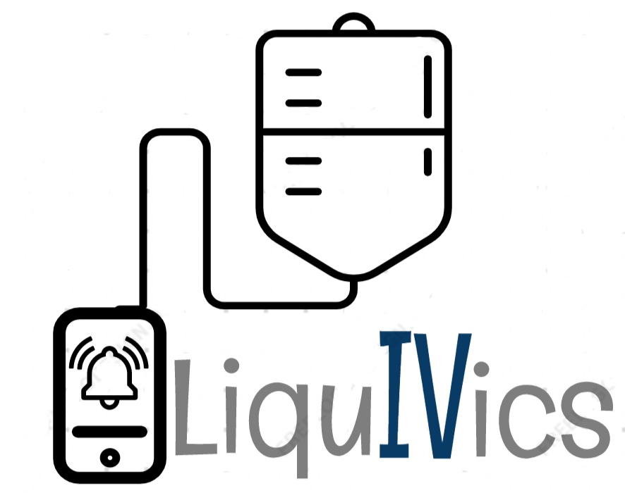

IoT based
Smart
Bottle for Health Care
Team - Desk

Slide 2
Introduction
Technological advancements have led to a significant increase in the recovery rate of patients.
There is still scope of improving patient care.
The flow in an IV is a manual task.
If the flow isn’t regulated properly, it may cause fatal results like death due to air bubbles in blood.
It will also prevent backflow of blood in the intravenous line.
If this task is digitalized, it would help in systematic execution with precision and hence reducing health hazard.

Slide 3
Objective
An IoT based IV drip monitoring system.
When fluid level in IV bottle is low, it will alert the observer through mobile at the control room.
The room number of patient will be displayed for quick recovery.

Slide 4
Our Solution
Hardware
An IOT based smart bottle with automatic fluid flow regulation for healthcare.
Software
A mobile application for easy control of the hardware.

Slide 5
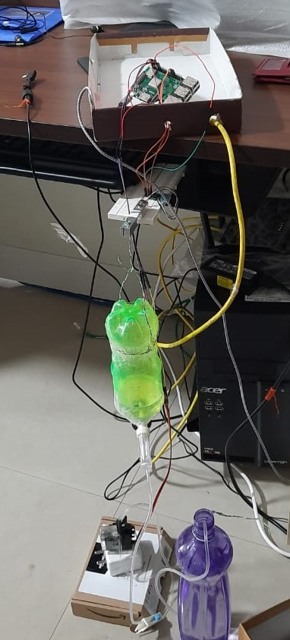
Hardware Features
Respberry Pi-3
Weight sensor
Servo-motor
Analogue-to-Digital converter
Pairs of connecting-wires and bottle

Slide 6
Software Features
Authentications login
Voice Notifier
Measuring and controlling flow/rate of liquid.

Slide 7
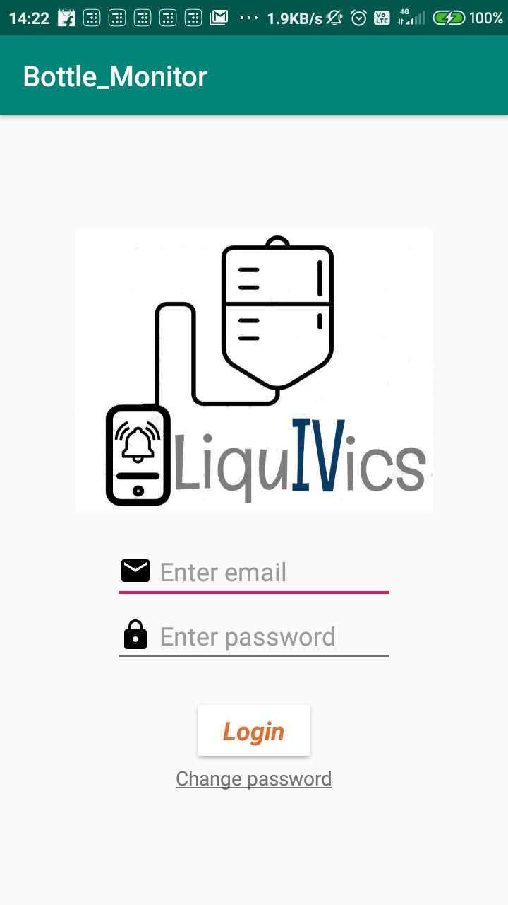
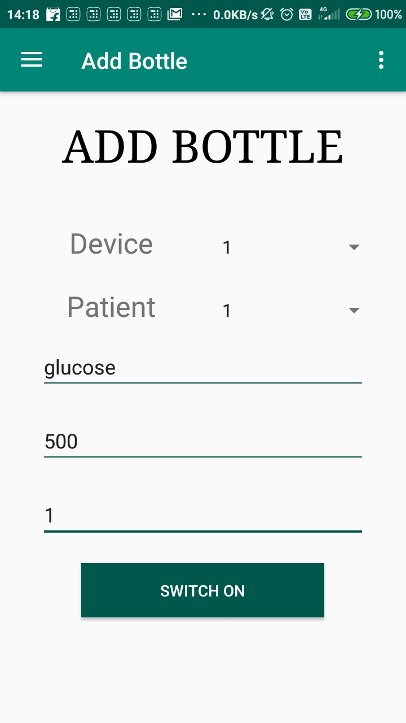
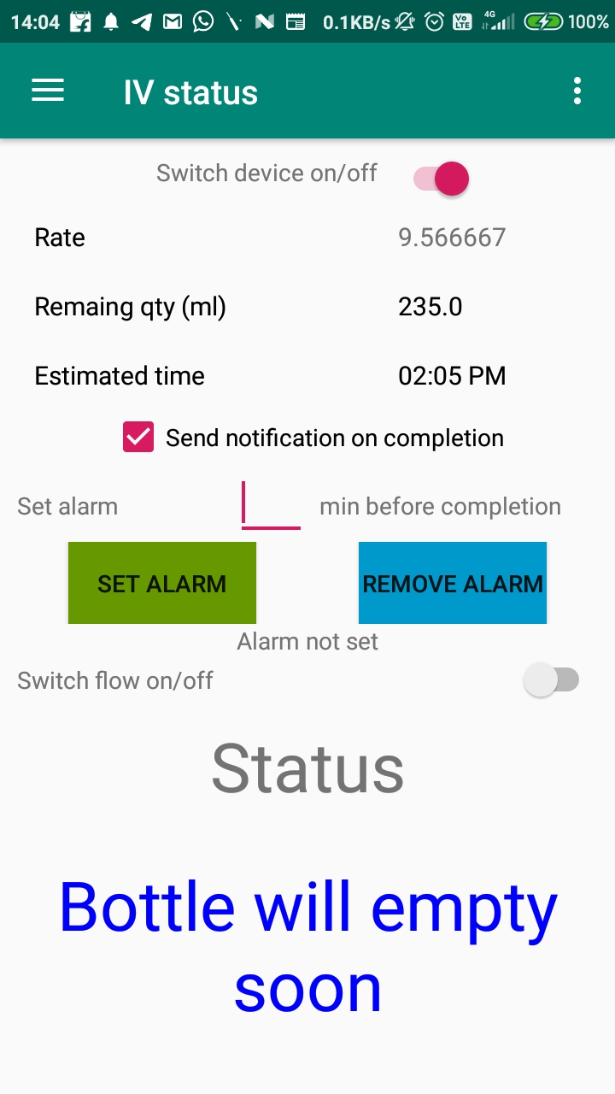
Working with Android App

Slide 8
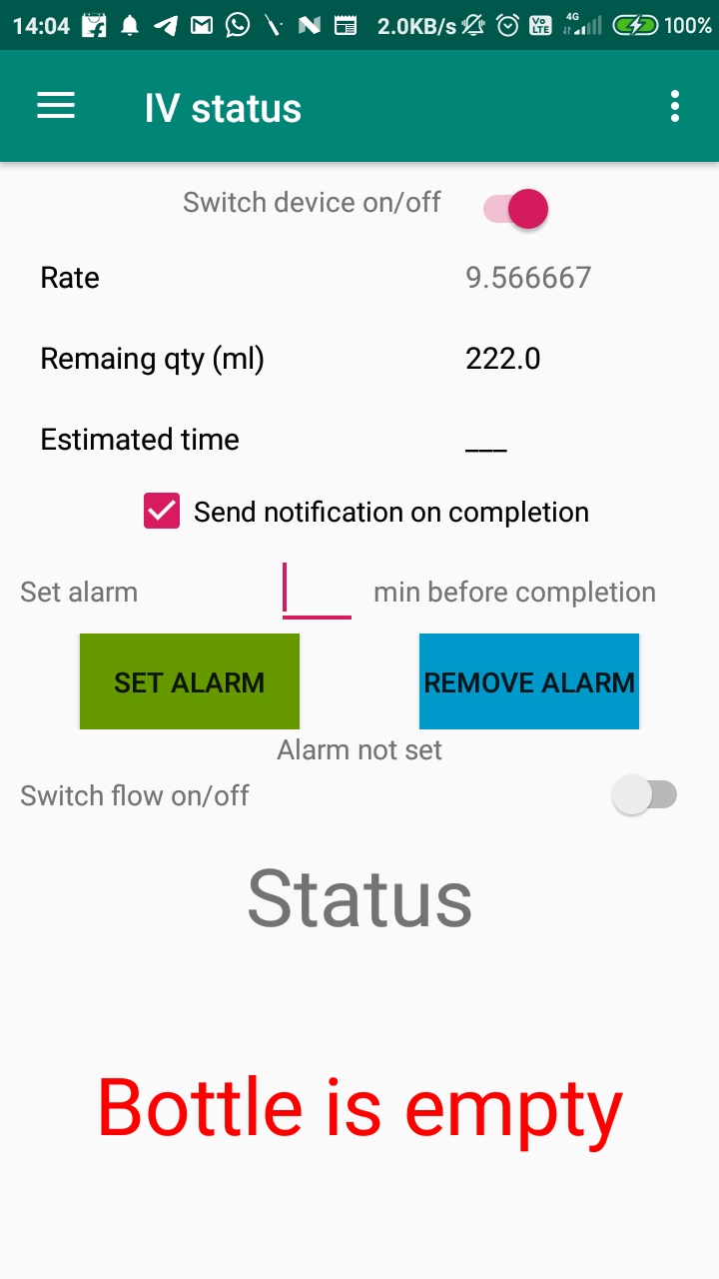

Working Results
Notification

Slide 9
Technologies Used
Hardware
Raspberry Pi as an interface.
Servo-motor for managing the flow percentage.
Weight sensor to estimate the fluid level.
Software
Firebase for back-end (authentication, storage, database).
Android studio to develop the front-end.
Java and XML as the overall languages for the development.
Git for version control.

Slide 10
THANK YOU

